Slide 1
PLANNED DEVELOPMENTS AT NSIMBI EDUCATION CENTRE SEPT. 2023 AND BEYOND
PRESENTATION TO TONSBERG ROTARY CLUB
AND
HOLMESTRAND ROTARY CLUB

Slide 2
PROPOSED CLASSROOM, OFFICES, SICKBAY AND GIRLS DORMITRY BLOCK – THE APPROVED PLAN.

Slide 3
INFORMATION
The three-floor building is intended to have some classrooms on the ground floor, offices on the first floor and a girls dormitory on the second floor.
The current plan is to construct the first floor as fast as resources will be available. Will temporarily be used as follows:
One of the rooms as a sickbay.
Temporary offices with cardboard partitioning.
A library and book store

Slide 4
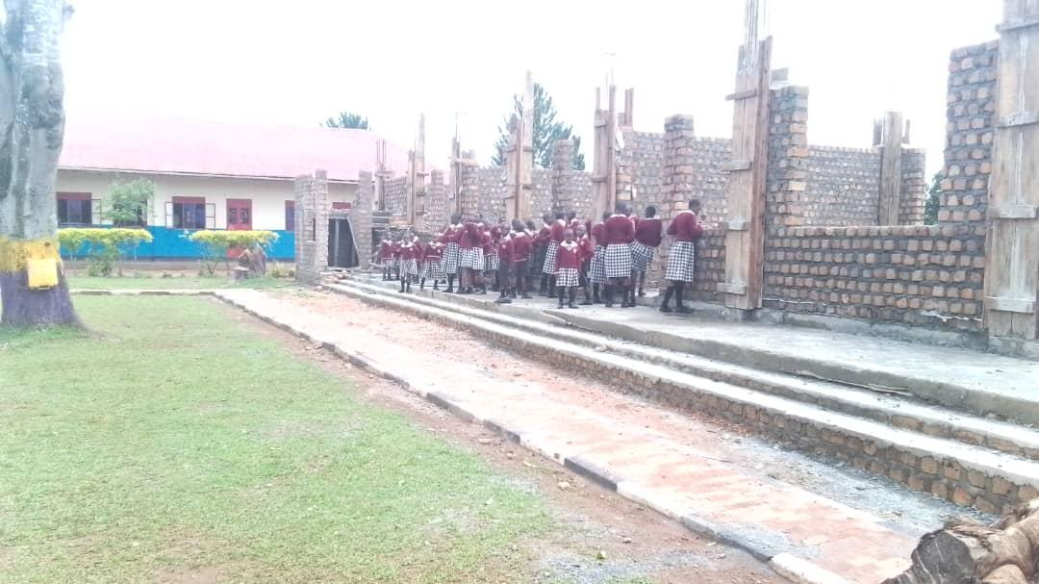
Construction underway - Pictorial
With income from timber sales, savings from the various school projects, we have managed to start on the construction of this building:

Slide 5
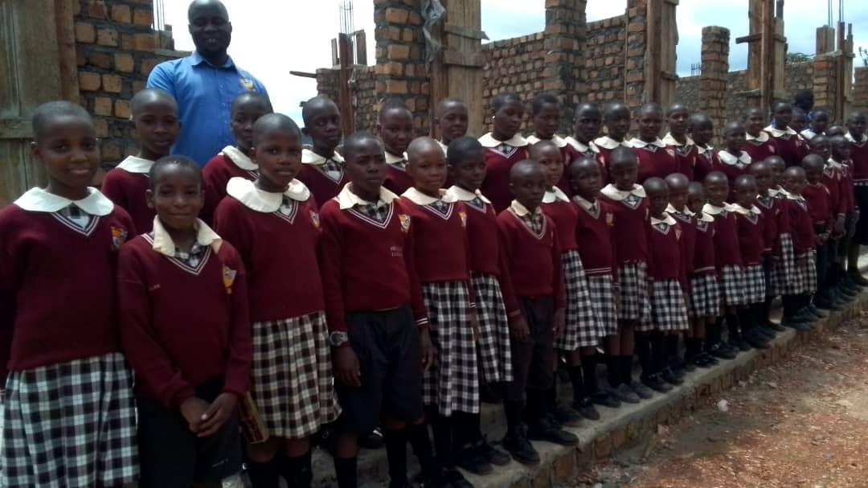
Guided Tour of Block Under construction:

Slide 6
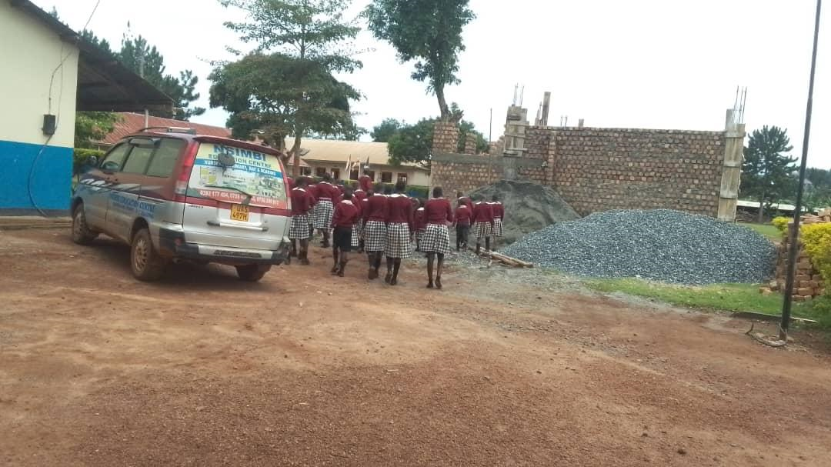
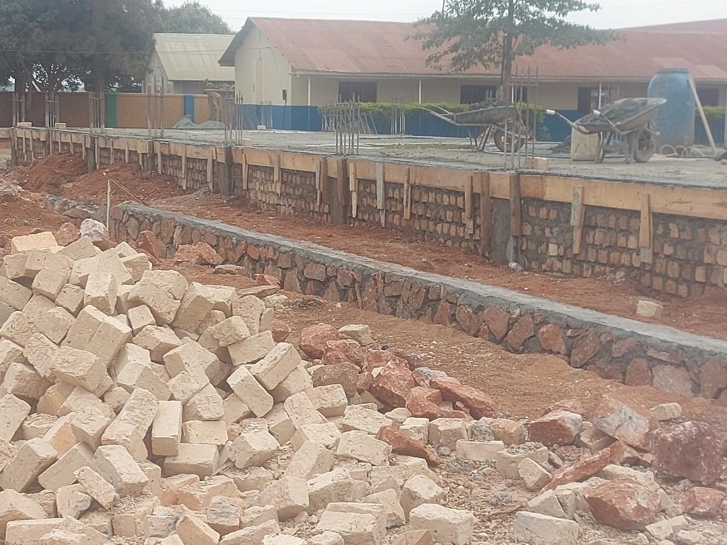
PICTURES

Slide 7
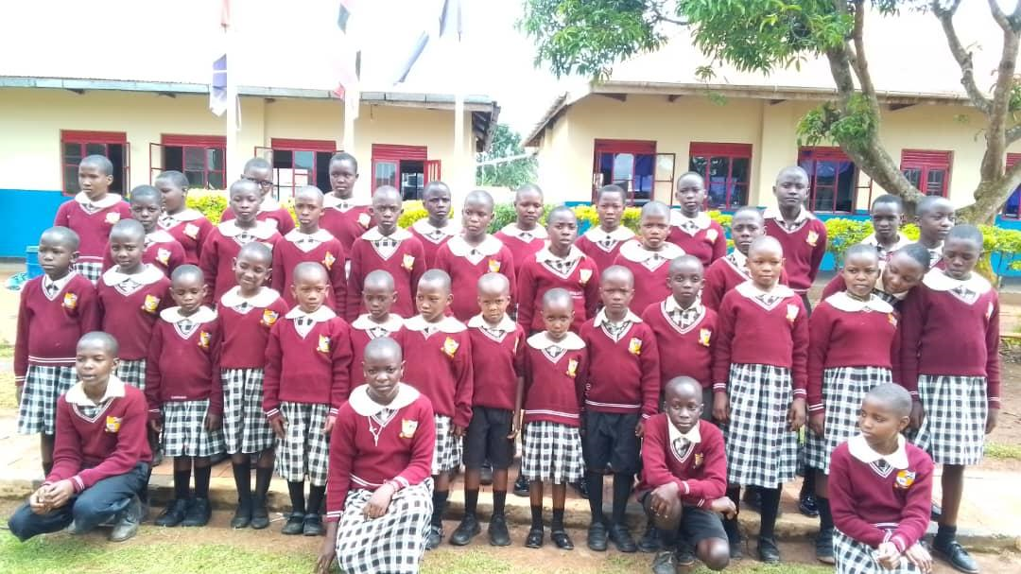
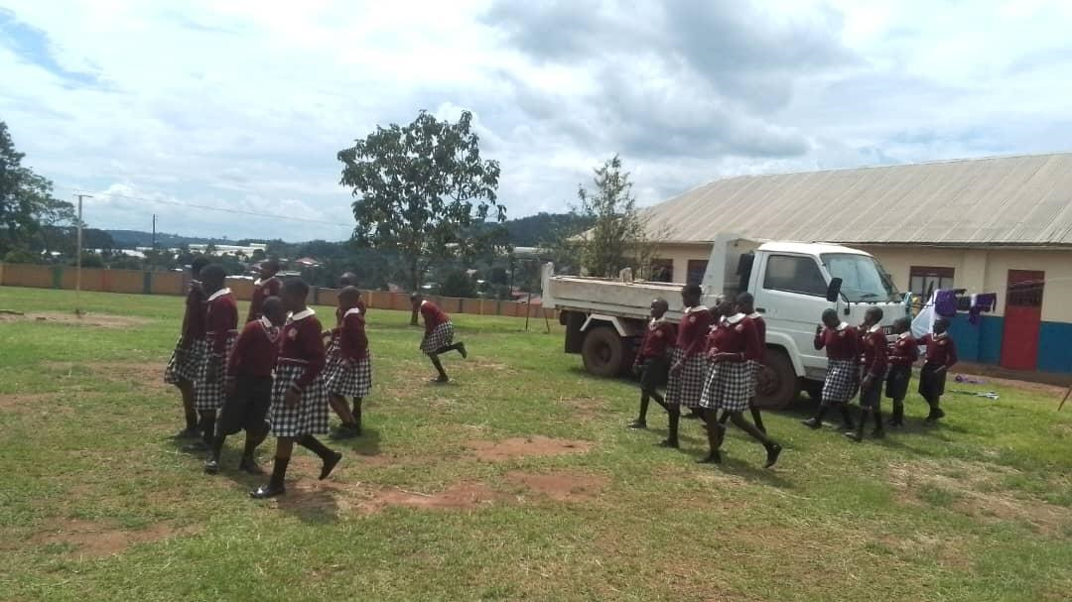
Pictures

Slide 8
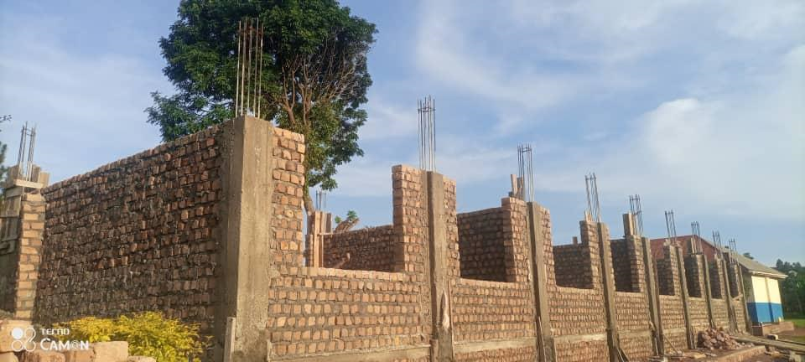
CURRENT STATE OF THE BUILDING:

Slide 9
CURRENT STAGE
All the timber that was used in construction was harvested from the trees planted around the school.
Parents with pupils at the school have supplied building materials for the project. Sourcing from parents is intended to empower them economically and promote collaboration with the school.

Slide 10
CHICKEN PROJECT FOR BIO-GAS SUPPORT
The chicken have not been doing well in the cages. They were becoming lame and the eggs production was low because of being restricted in movement. We have made a survey and we would like to construct another kind of house where we can collect the chicken droppings for the biogas project.
We shall be using local materials especially wood off-cuts most of which we have from the timber harvesting. The rest of the materials are budgeted for 6,500,000/=.
The permanent chicken houses will be used for broiler chicken and their litter for manure in our gardens. Currently we are using the pig dung to feed the biogas digester.

Slide 11
PROPOSED TYPE OF BUILDING TO ENABLE US COLLECT THE CHICKEN DROPPINGS FOR THE BIOGAS
PROPOSED TYPE OF CHICKEN HOUSE.mp4

Slide 12
BIOGAS PROJECT
As highlighted above, the chicken were not doing well in the cages, hence the production of chicken litter for the bio-digester reduced. Consequently, the gas production reduced.
With the input from the piggery, gas is produced to prepare the tea, porridge and sauce. However, we need to enhance it with the chicken droppings.
We have a source for new technology where we can harvest the chicken litter without necessarily putting the chicken in cages. This will be able to provide the required quantities of litter to feed the bio-digester.

Slide 13
A BI THANK YOU TO YOU ALL!!!
We thank you for all the contributions that have been extended to Nsimbi Education Centre. We do not take this for granted!
This has made a great impact in terms of better facilities, more efficient resource utilization and a more conducive learning environment for the pupils.
ONCE AGAIN, THANK YOU VERY VERY MUCH!!!

